Slide 1

CNE Renewal Process
CNE Board of Commissioners

Slide 2
CNE Renewal
  This flexible program recognizes that you and your colleagues represent various career levels, have different educational needs and career goals, and varying degrees of access to continuing education. Thus, requirements for maintaining certification can be met through multiple sources and a variety of professional development activities intended to help individuals prepare for the challenges ahead and maintain a professional edge by:
    Preserving the currency of hard-earned certification credentials
    Expanding their knowledge
    Reinforcing skills
    Improving job performance
    Demonstrating commitment to excellence
    Increasing competitive advantage

Slide 3
Requirements for Maintaining
Requirements for Maintaining Your CNE
Hold an active registered nurse (RN) license in United States or its territories.
Have the equivalent of two or more years of employment in the past five years functioning in the full scope of the academic faculty role.
Have Certified Nurse Educator Code of Ethics compliance.
Pay renewal fees by the certification expiration date.
Maintain five-year cycle, refer to certificate for expiration date.
Demonstrate continued maintenance or expansion of your knowledge relevant to the role of academic nurse educator within the five-year renewal cycle. Candidate must choose from one of the following:
  Option A: Submit documents to support competence was maintained or enhanced.
  Option B: Pass the CNE exam before the due date for the certification renewal documents.

Slide 4
Retired Option
The Retired option is available for CNEs who are retiring from academic teaching and wish to retain the credential. The Retired status as a form of renewal is a life-long status not requiring a renewal on a time cycle (i.e., five years). After approval, the credential designation “CNE Ret” may be used.

Slide 5
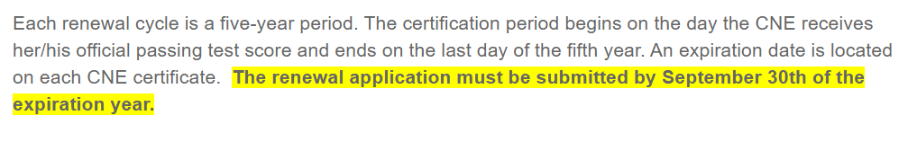
Renewal Cycles

Slide 6
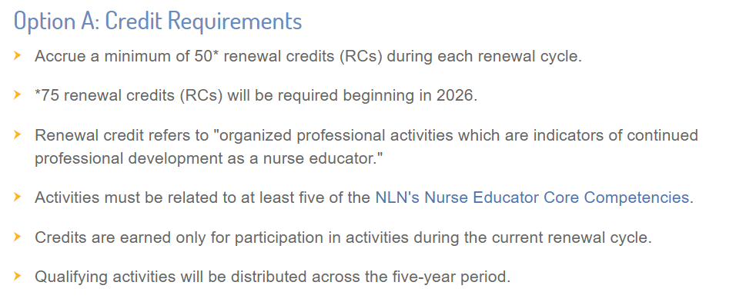
Renewal Option A

Slide 7
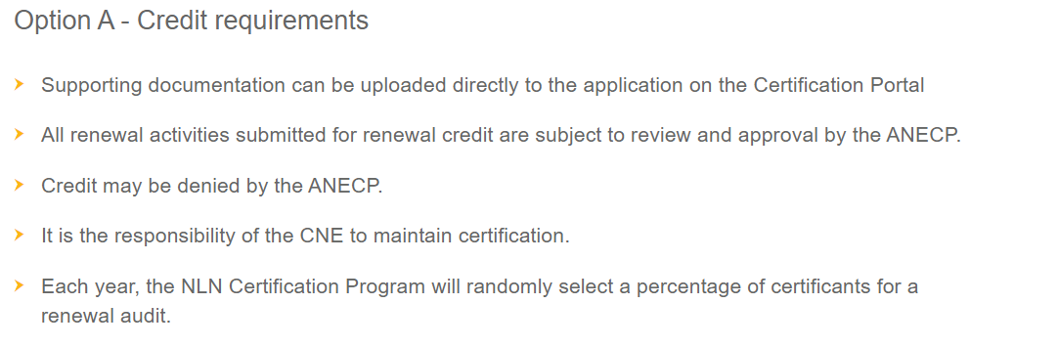
Renewal Process : Option A

Slide 8
Renewal Credit Guide
Professional development activities related to continued learning and development in the academic nurse educator role
The activities must be completed during the current renewal cycle
Activities must be distributed throughout the five-year period
You are able to upload activities via the Certification Portal to your Profile as you collect them
As you upload them you must select the competency area that the activity addresses, the activity start/end date, activity details, renewal credits and reflection on how the activity met the competency and/or task statement. Once this information is inputted upload the supporting document.
Each activity must be entered as one event to only one competency. For example, academic courses must be used one by one and attached to the appropriate competency. The degree work may not be “clumped” into one declaration (i.e., 50 RCs for coursework in a PhD program). Each activity must be declared and a reflection written for each one.

Slide 9

Walk through Activity uploads
Go to: www.nln.org/certification/Certification-for-Nurse-Educators/cne
Select “CNE Renewal” from the Resources list on the left sidebar
Review the information and links for Renewal
Click on
Then enter your username and password

Slide 10
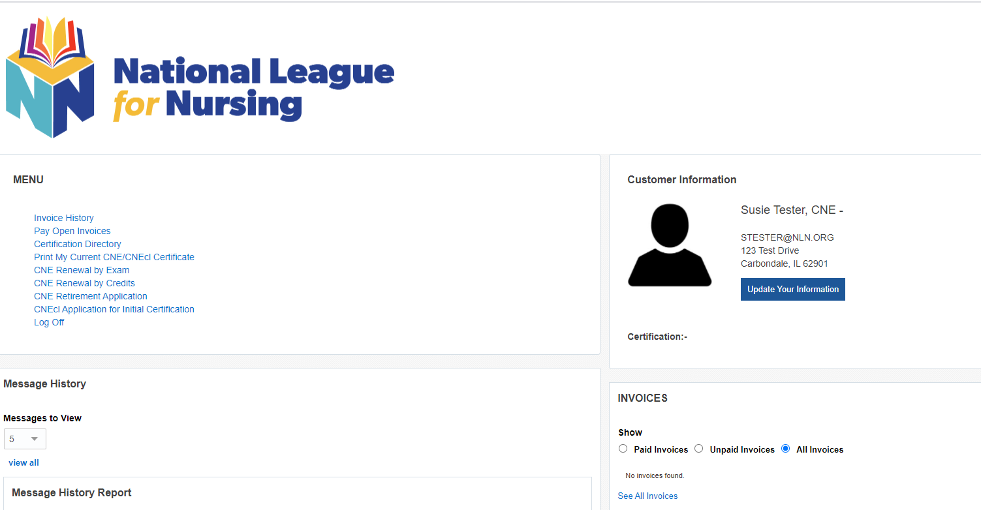
Menu
Under the left-hand side Menu box select: CNE Renewal by Credits

Slide 11
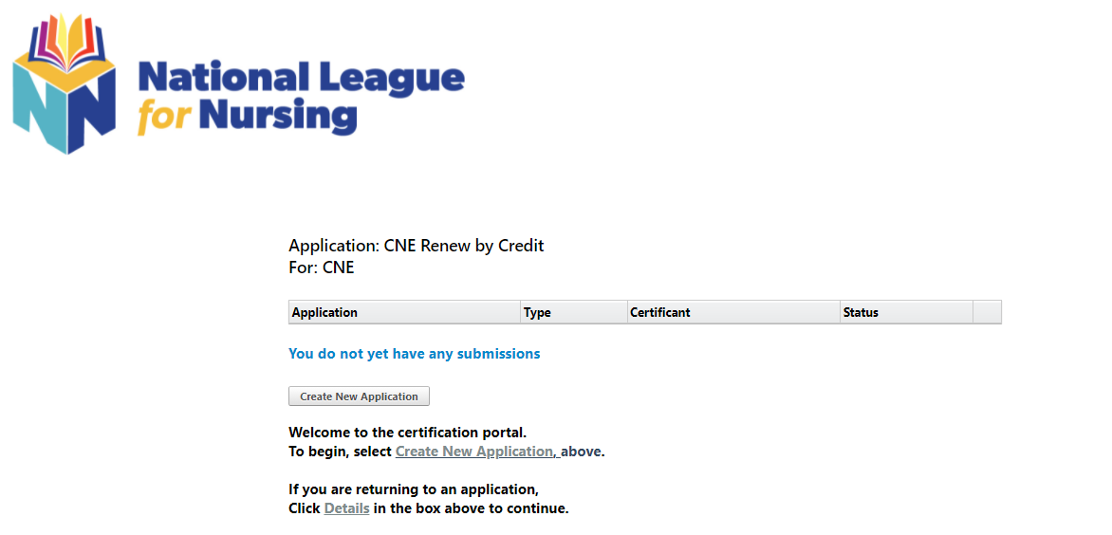
Starting application for the first time
Select create new application

Slide 12
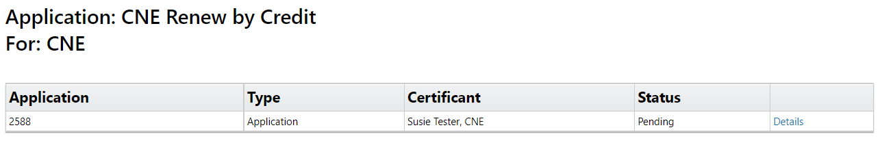
Subsequent log in view
Select details to the right of the box

Slide 13
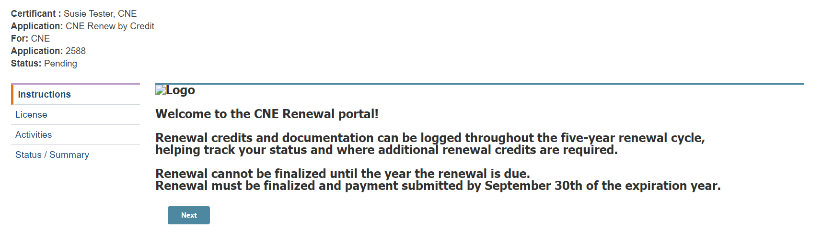
Renewal credit documentation
On the left hand side you will need to click on activities

Slide 14

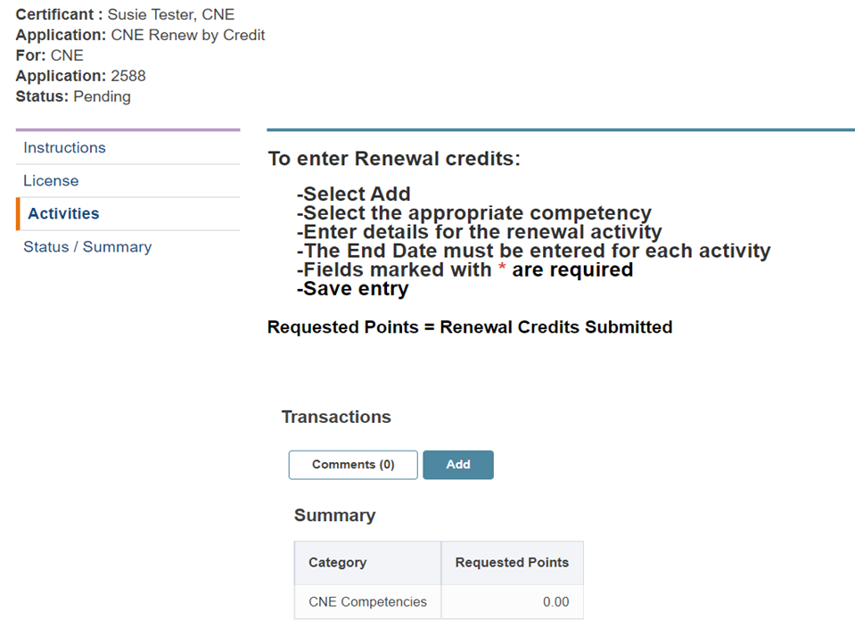
Enter renewal credits
Under the transactions area select :

Slide 15
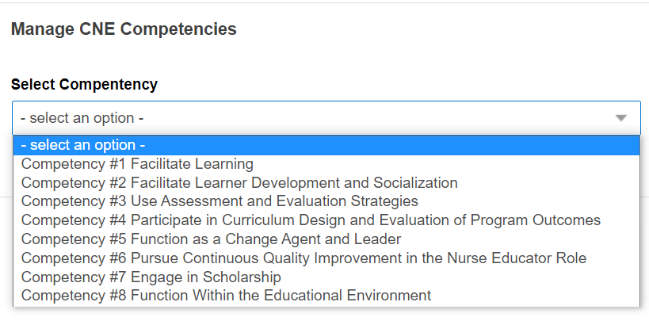
Manage CNE Competencies
Select the appropriate competency based on your review of the cne-renewal-credit-guide

Slide 16
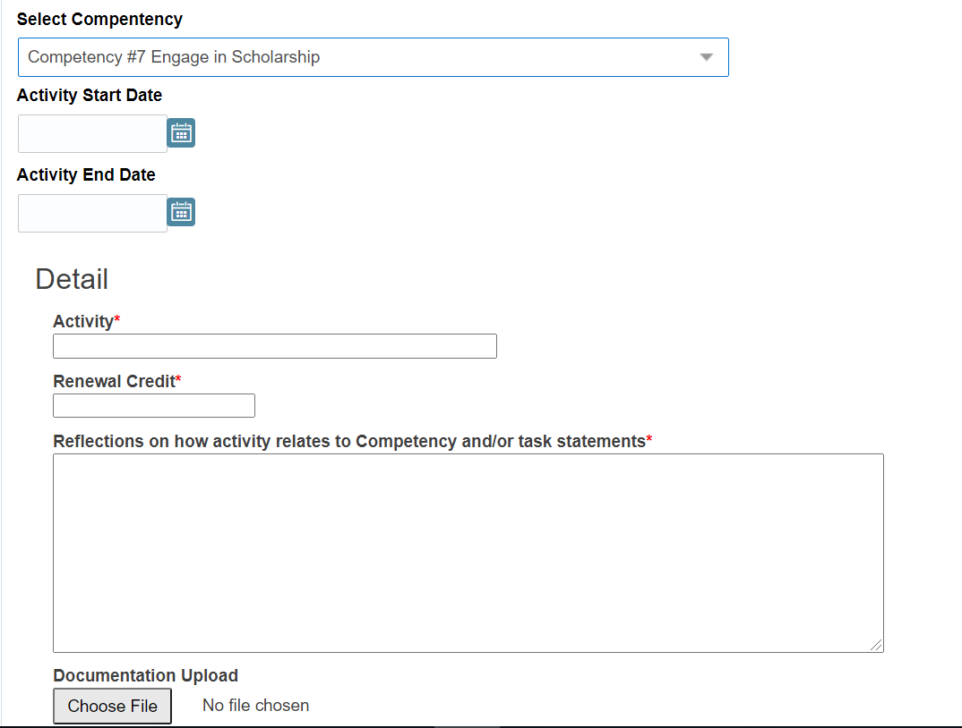
Manage CNE Competency

Slide 17
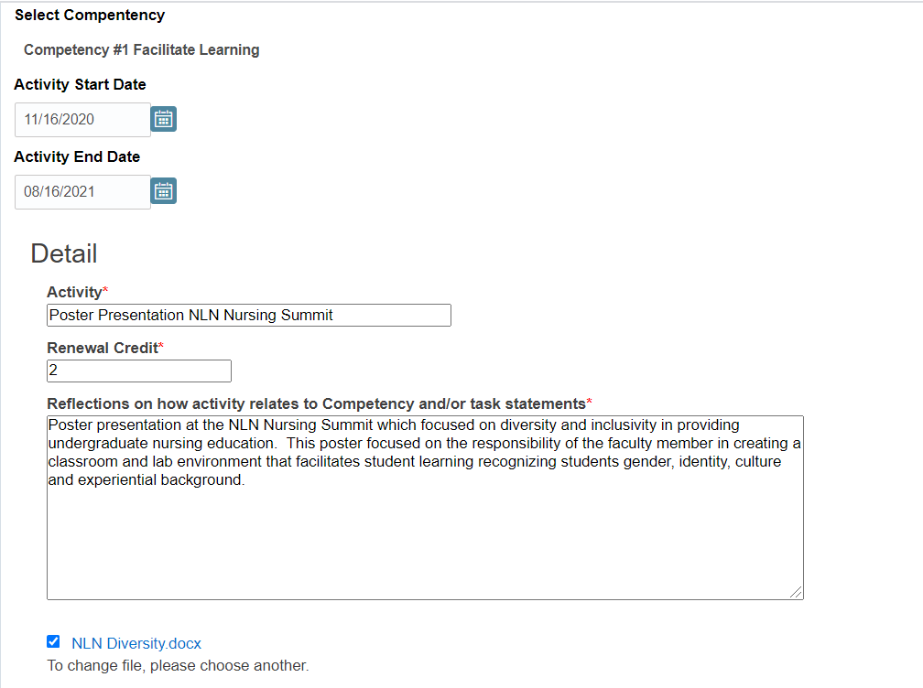
Complete the necessary field and upload supporting documents

Slide 18
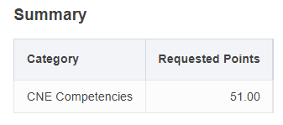
Enter all required renewal credits
Once you have entered all of your desired activities you will see a summary section which tells you how many hours have been submitted.
Ensure you have met the minimum 50 renewal credits (75 renewal credits by 2026 renewal)

Slide 19
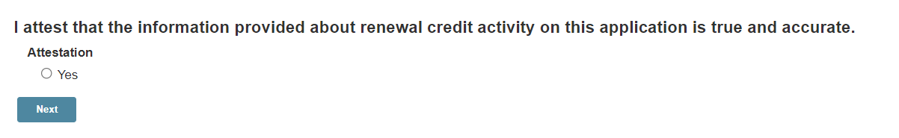
Once all hours entered
Once all of the renewal credits have been entered click next
You will then be sent to the attestation page.

Slide 20
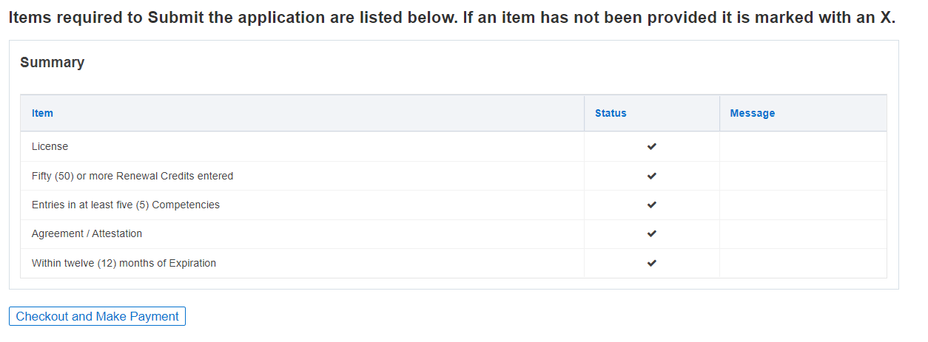
Status/Summary
You will now see a summary page with a status of all of the requirements

Slide 21
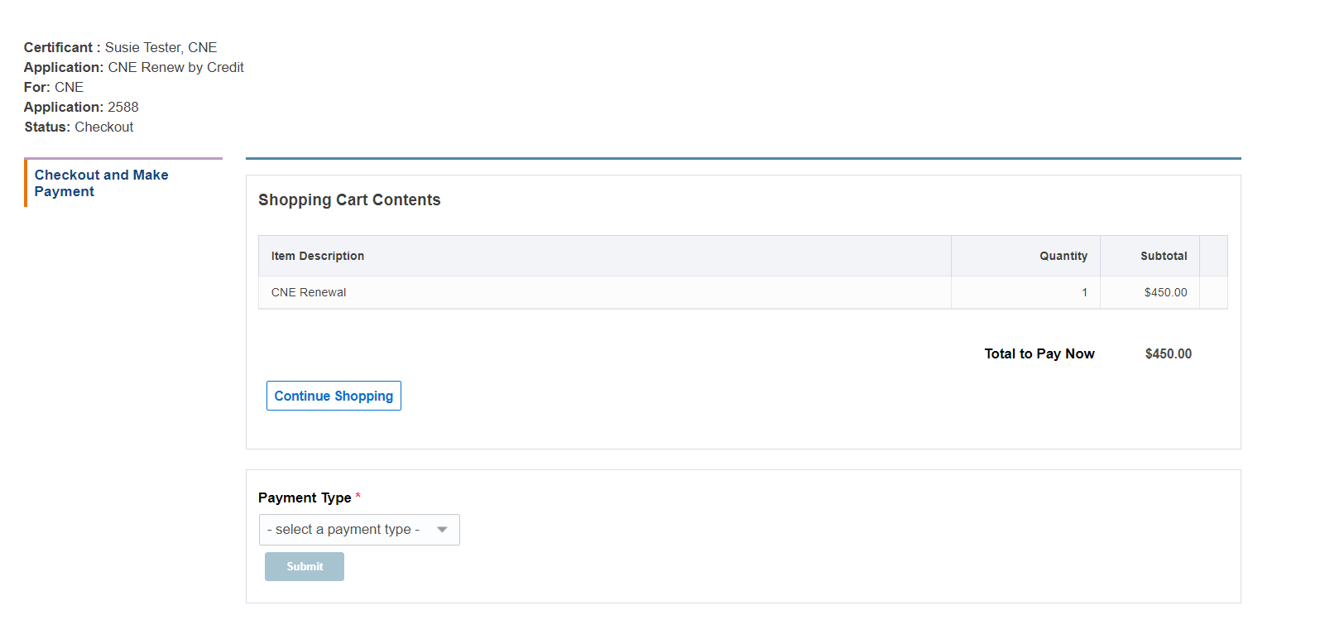
Checkout and Payment

Slide 22
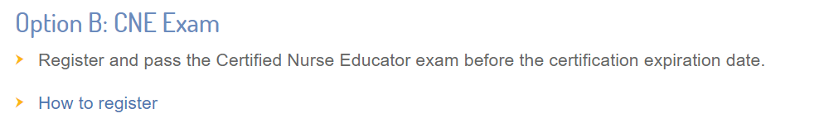
Renewal Option B

Slide 23
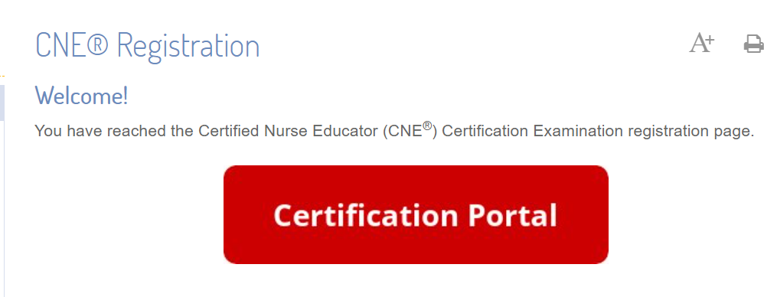
CNE Registration
If you choose to re-certify by exam enter the Certification Portal

Slide 24
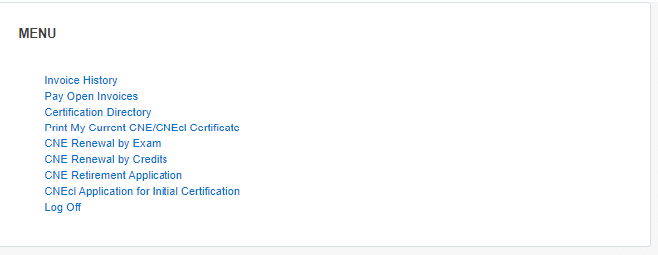
CNE Renewal by Exam
On the certification portal select: CNE Renewal by Exam and create new application and complete

Slide 25
Complete application
Review the CNE Handbook
Complete the application registration and payment
Within the 90 day window schedule and complete your examination
You will receive an email confirmation from our testing partner, Scantron, that will be sent to the email of record, to schedule an exam date.

Slide 26
Re-certification
If you have any questions please feel free to reach out to us at certification@nln.org.

