Slide 1
Illinois League for Nursing
Annual Meeting
October 16, 2015
Springfield, IL

Slide 2
Learning Objectives
At the end of this session, you will be able to describe:
the concept of integrating health care and public health
how policy development fosters a healthier individual and community
the health equity framework for which policy can be based
the urgency of integrating health care and public health as illustrated by the obesity epidemic

Slide 3
Why Should Primary Care Care about Population Health and Why Should Population Health Care about Primary Care?
Dramatic rise in health care costs
Social and environmental determinants of health
Effect of primary prevention
Enhance capacity of both sector’s mission – improving health

Slide 4
Support for Integration
Institute of Medicine Committee, 2012
Findings:
Principles of integration ripe
Common goal of population health improvement
Community engagement to define/address needs
Aligned leadership
Sustainability through stronger infrastructures and engagement of multiple agencies
Collaborative use of data and analysis
Current patterns of health policy focus and investment does not leverage assets and potential
Emerging models of health care delivery and public health can be leveraged to promote alignment
Source: http://www.nap.edu/download.php?record_id=13381

Slide 5
Support for Integration
Institute for Healthcare Improvement: Triple Aim
Improving the patient experience of care (including quality and satisfaction)
Improving the health of populations
Reducing the per capita cost of health care
“IHI believes that to do this work effectively, it’s important to harness a range of community determinants of health, empower individuals and families, substantially broaden the role and impact of primary care and other community based services, and assure a seamless journey through the whole system of care throughout a person’s life.”
Source: http://www.ihi.org/engage/initiatives/tripleaim/Pages/default.aspx

Slide 6
Policy Development A Core Function of Public Health
The foundation for public health lies within the 3 core functions defined by the IOM:
Assessment
Policy Development
Assurance
Source of core functions: Institute of Medicine. The Future of Public Health. 1988.
Source of Ten Essential Public Health Services: Core Public Health Functions Steering Committee, 1994

Slide 7
Public Health Core Functions and 10 Essential Services
Source: Core Public Health Functions Steering Committee, 1994

Slide 8
Policy Examples
CDC defines "policy" as a law, regulation, procedure, administrative action, incentive, or voluntary practice of governments and other institutions.
Source: http://www.cdc.gov/stltpublichealth/policy/
Seat belt use
Alcohol and tobacco control
Worksite wellness
School physical activity and wellness
Sugary drink tax
Marketing restrictions to youth
School/ECE nutrition
Healthy vending machines
Baby Friendly Hospitals
Environmental asthma triggers

Slide 9
Public Health System
Schools
Civic Groups
Nursing
Homes
EMS
Neighborhood Organizations
Community Centers
Nonprofit
Organizations
Hospitals
Home Health
Drug Treatment
Public Health Agency
Laboratories
Doctors
Mental Health
Law Enforcement
Faith Institutions
Tribal Health
Fire
Transit
CHCs
Employers
Elected Officials
Corrections

Slide 10
Health Equity = Healthy Individuals = Healthy Communities
Source: This graphic is an excerpt from the “Determinants of Equity” report, released by the King County Health Department in January, 2015.

Slide 11
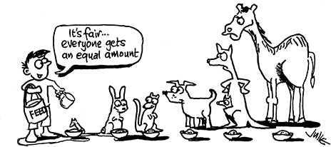
So, what do we mean by Health Equity?

Slide 13
A Framework for Health Equity
Socio-Ecological
A Framework for Health Equity
Medical Model
Socio-Ecological
A Framework for Health Equity
Medical Model
Socio-Ecological
A Framework for Health Equity
Medical Model
Socio-Ecological
Medical Model
INDIVIDUAL
HEALTH
KNOWLEDGE
INDIVIDUAL
HEALTH
KNOWLEDGE
INDIVIDUAL
HEALTH
KNOWLEDGE
GENETICS
INDIVIDUAL
HEALTH
KNOWLEDGE
GENETICS
Upstream
GENETICS
Downstream
Upstream
GENETICS
Downstream
Upstream
Downstream
Upstream
Downstream
Discriminatory
Beliefs (Isms)
Race
Class
Gender
Immigration status
National origin
Sexual
orientation
Disability
Institutional Power
Corporations & other businesses
Government agencies
Schools
Social
Inequities
Neighborhood conditions
- Social
- Physical
Residential segregation
Workplace conditions
Risk Factors &
Behaviors
Smoking
Nutrition
Physical
activity
Violence
Chronic Stress
Disease
& Injury
Infectious
disease
Chronic
disease
Injury (intentional & unintentional)
Mortality
Infant
mortality
Life
expectancy
Discriminatory
Beliefs (Isms)
Race
Class
Gender
Immigration status
National origin
Sexual
orientation
Disability
Institutional Power
Corporations & other businesses
Government agencies
Schools
Social
Inequities
Neighborhood conditions
- Social
- Physical
Residential segregation
Workplace conditions
Risk Factors &
Behaviors
Smoking
Nutrition
Physical
activity
Violence
Chronic Stress
Disease
& Injury
Infectious
disease
Chronic
disease
Injury (intentional & unintentional)
Mortality
Infant
mortality
Life
expectancy
Discriminatory
Beliefs (Isms)
Race
Class
Gender
Immigration status
National origin
Sexual
orientation
Disability
Institutional Power
Corporations & other businesses
Government agencies
Schools
Social
Inequities
Neighborhood conditions
- Social
- Physical
Residential segregation
Workplace conditions
Risk Factors &
Behaviors
Smoking
Nutrition
Physical
activity
Violence
Chronic Stress
Disease
& Injury
Infectious
disease
Chronic
disease
Injury (intentional & unintentional)
Mortality
Infant
mortality
Life
expectancy
Discriminatory
Beliefs (Isms)
Race
Class
Gender
Immigration status
National origin
Sexual
orientation
Disability
Institutional Power
Corporations & other businesses
Government agencies
Schools
Social
Inequities
Neighborhood conditions
- Social
- Physical
Residential segregation
Workplace conditions
Risk Factors &
Behaviors
Smoking
Nutrition
Physical
activity
Violence
Chronic Stress
Disease
& Injury
Infectious
disease
Chronic
disease
Injury (intentional & unintentional)
Mortality
Infant
mortality
Life
expectancy
HEALTHCARE ACCESS
HEALTH STATUS
SOCIAL FACTORS
HEALTHCARE ACCESS
HEALTH STATUS
SOCIAL FACTORS
HEALTHCARE ACCESS
HEALTH STATUS
SOCIAL FACTORS
HEALTHCARE ACCESS
HEALTH STATUS
SOCIAL FACTORS
- Adapted by ACPHD from the Bay Area Regional Health Inequities Initiative, Summer 2008
- Adapted by ACPHD from the Bay Area Regional Health Inequities Initiative, Summer 2008

Slide 14
Basic Definitions
This slide is an excerpt provided by THRIVE WI.

Slide 15
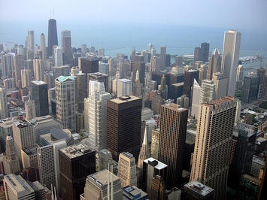
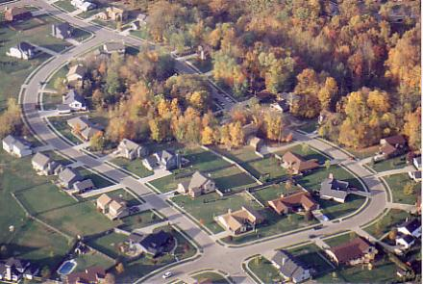
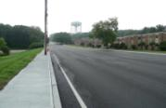
It’s All Connected
Cities
Neighborhoods
Buildings, Parks, Streets
Schools
Businesses
Homes
Sidewalks
Restaurants
Grocery Stores
Factories
Pollution

Slide 16
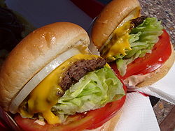
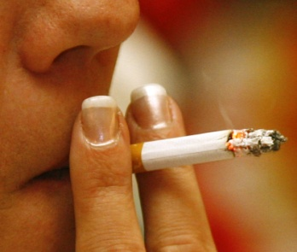
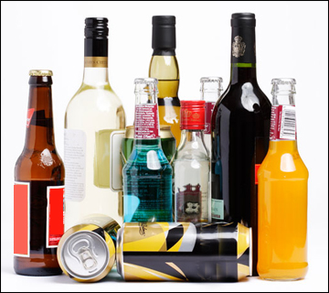
Links - Behaviors & Outcomes
Diet & Activity Patterns
Heart Disease
Cancer
Tobacco
Stroke
Diabetes
Alcohol & Drugs
Injuries and Violence

Slide 17
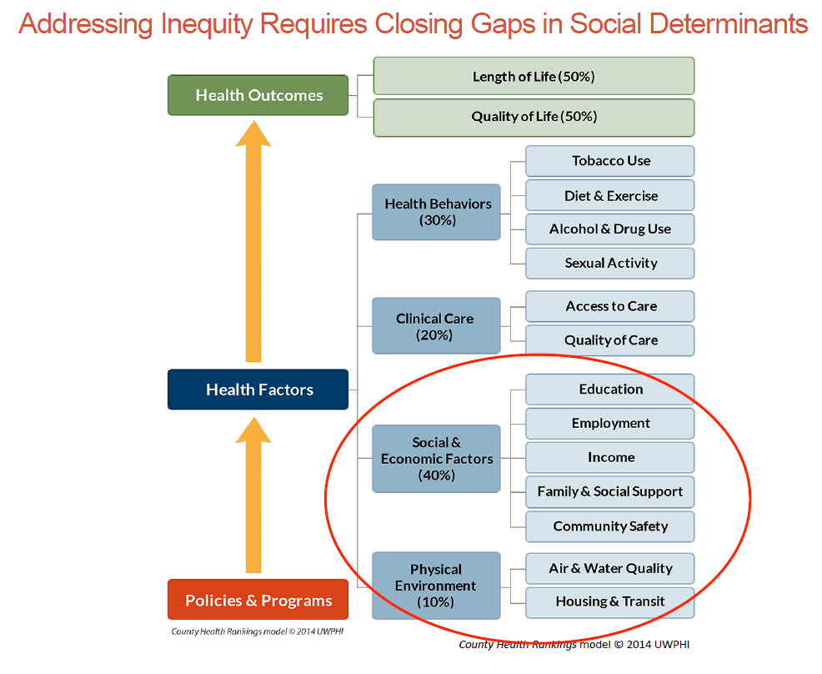
Exposures and Health Outcomes

Slide 18
Urgency!!

Slide 19
Illinois Adult Obesity

Slide 20
Illinois Childhood Obesity

Slide 21
Obesity-Related Health Issues

Slide 22
Obesity-Related Health Issues

Slide 23
IOM Proposal: Integrating Clinical and Community Systems
System that is centered on individual patients and family engagement. The authors note that successful obesity treatment models often require behavioral changes such as preparing nutritious foods or increasing physical activity, and families play a key role in these efforts.
Restructured clinical services provided by physicians who are sensitive to the stigmatization of people with obesity. Physicians and staff need to learn behavioral strategies that can motivate patients to change their dietary habits and start exercising.
Better integration between clinical services and community systems that can make it easier for patients to lose or maintain their weight. For example, partnerships between clinics and YMCAs or other community-based resources can provide opportunities for structured regular exercise and/or nutrition counseling.
Source: The Integrated Clinical and Community Systems for the Prevention and Management of Obesity Innovation Collaborative of the Institute of Medicine’s Roundtable on Obesity Solutions
Source: http://www.aafp.org/news/health-of-the-public/20150922obesitymodel.html

Slide 24
Of all the forms of inequality,
injustice in health care
is the
most shocking
and
inhumane.
Martin Luther King Jr

Slide 25
Resources
A PRACTICAL PLAYBOOK: Public Health. Primary Care. Together.
https://www.practicalplaybook.org/
The Community Guide
http://www.thecommunityguide.org/obesity/communitysettings.html
Centers for Disease Control and Prevention, Public Health Policy
http://www.cdc.gov/stltpublichealth/policy/
Kaiser Family Foundation, Preventive Services Tracker
http://kff.org/health-reform/report/preventive-services-tracker/

Slide 26
Thank you!
Arlene Ryndak, MPH, RN
aryndak@lakecountyil.gov
847.377.8107

