Slide 1
Mental Health Needs of Older Adults
www.nln.org/ACES

Slide 2
Essential Nursing Actions
Assess Function and Expectations | Assess, respond to, and respect an older adult’s functional status and strengths, wishes, and expectations. Determine the older adult’s function and expectations, along with cognition, mood, culture, physiologic status, and comfort to obtain a comprehensive assessment of health care needs. Use standardized assessment tools to assess the older adult’s individual aging pattern.
Coordinate and Manage Care | Manage chronic conditions, including atypical presentations, in daily life and during life transitions to maximize function and maintain independence. Assist older adults and families/caregivers to access knowledge and evaluate resources. Advocate during acute exacerbations of chronic conditions to prevent complications.
Use Evolving Knowledge | Understand geriatric syndromes and unique presentations of common diseases in older adults. Access and use emerging information and research evidence about the special care needs of older adults and appropriate treatment options. Interpret findings and evaluate clinical situations in order to provide high quality nursing care based on current knowledge and best practices.
Make Situational Decisions | Analyze risks and benefits of care decisions in collaboration with the interdisciplinary team and the older adult, family, and caregivers. Evaluate situations where standard treatment recommendations need to be modified to manage care in the context of the older adult’s needs and life transitions. Consider the older adult’s wishes, expectations, resources, lived experiences, culture, and strengths when modifying care approaches.

Slide 3
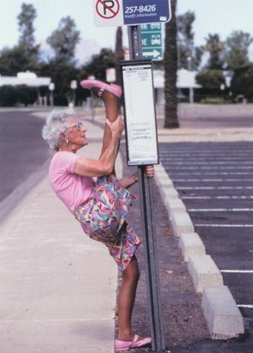
Assess Function and Expectations
Ask the question…
  What is current function and how far is current function from baseline?

Slide 4
Common Mental Health Issues Seen in Older Adults
Cognitive Issues
Mood Issues
Anxiety

Slide 5
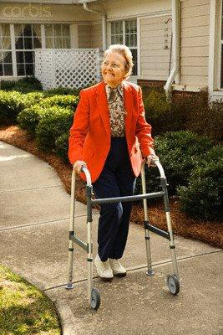
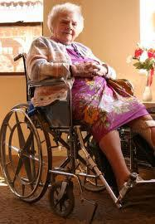
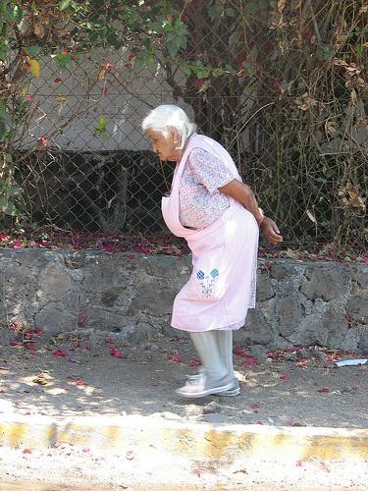
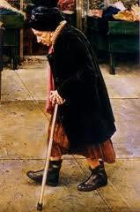
Functioning as a Predictor
Physical Assessments
Mental Health Assessments
Separate…Equal…and Intertwined

Slide 6
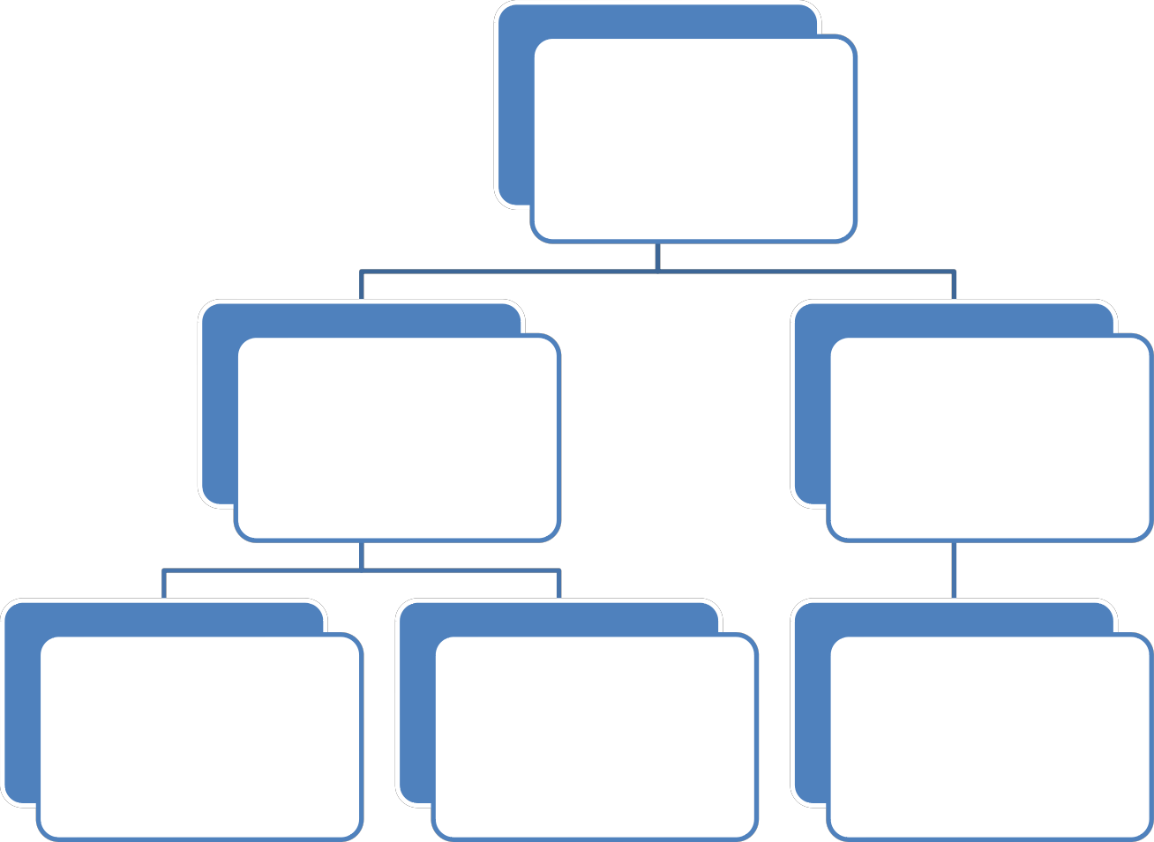
Cognitive Issues
COGNITIVE ISSUES
DEMENTIA
DELIRIUM
BASELINE STATUS
BEHAVIOR
PROGRESSION

Slide 7
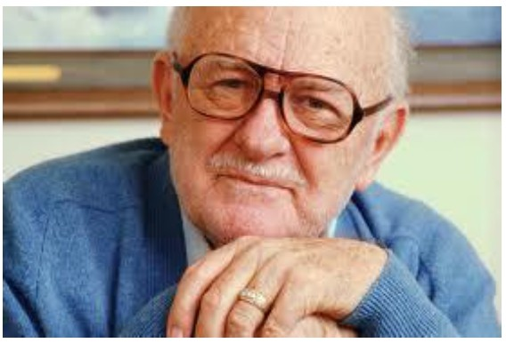
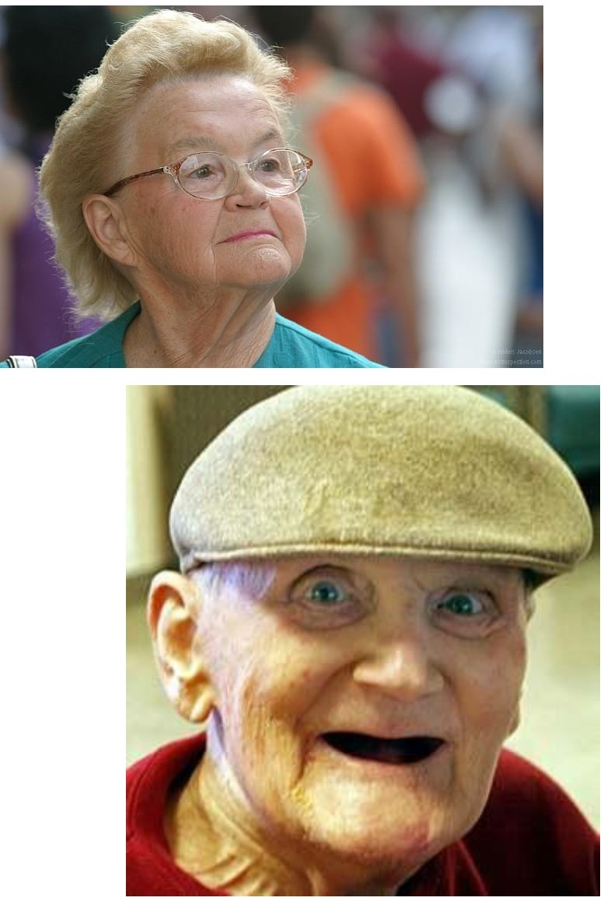
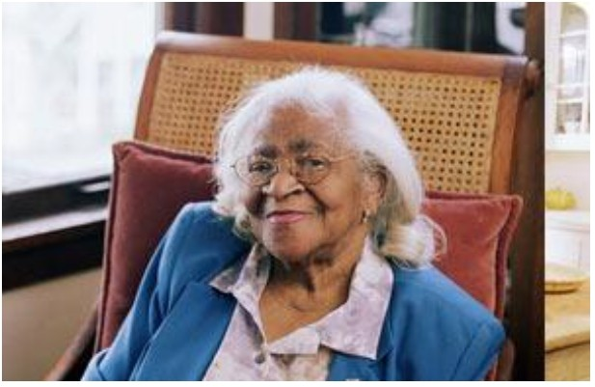
Atypical is the Norm with Cognitive Issues

Slide 8
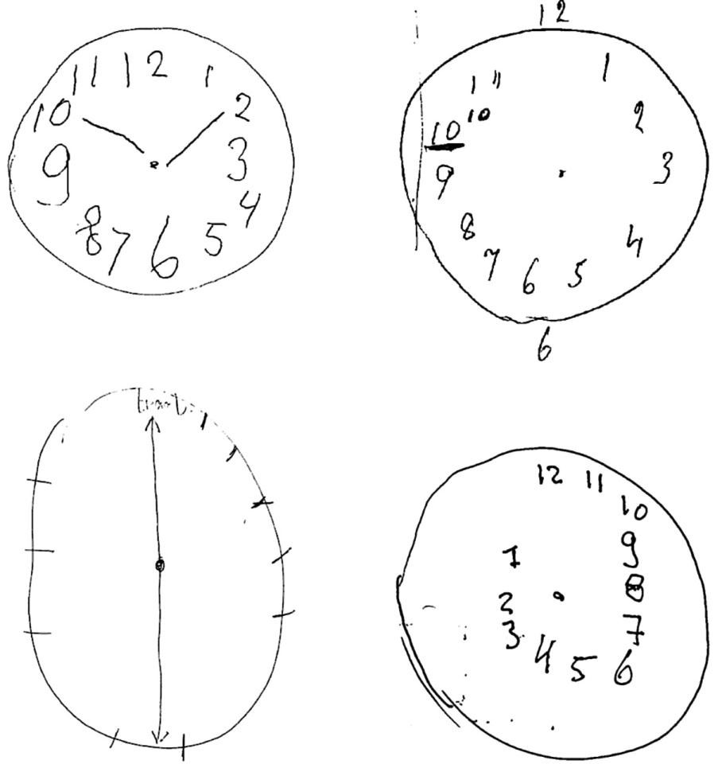
Cognitive Disorders
Baseline functioning
Time Frame of change
Functional disparity
Client perception
Family perception
Examiner’s perception

Slide 9

Coordination and Management of Care
Atypical Presentation of Cognitive Issues
    Baseline functioning
    Time Frame of change
    Client perception
    Family perception
    Examiner’s perception

Slide 10
Depression
TRANSITION
INTEREST
APPETITE
BEHAVIOR
SLEEP

Slide 11

Coordination and Management of Care
Atypical Presentation of Mood Disorders
    Baseline functioning
    Time Frame of change
    Client perception
    Family perception
    Examiner’s perception

Slide 12
Anxiety
TRANSITION
SYMPTOM OF DEPRESSION
BEHAVIORS
SYMPTOM OF DEMENTIA
BASELINE

Slide 13
ANXIETY
COPING MECHANISMS
COGNITIVE APPRROACH
RESTLESSNESS
SLEEP
ACTIVITIES OF DAILY LIVING
ANXIETY
ANXIETY

Slide 14



Mental Health Assessments
Mini-Cog
Geriatric Depression Scale
Caregiver Strain Index
Recognition of Dementia in hospitalized older adults
Short Michigan Alcohol Screening Tool

Slide 15
But you’re doing ok for your age

Slide 16
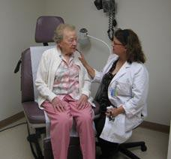
Use Evolving Knowledge
Geriatric Syndromes – clusters of related symptoms that are complicated…
overwhelming to practitioners…and often overlooked
Dementia…Delirium…and Depression

Slide 17

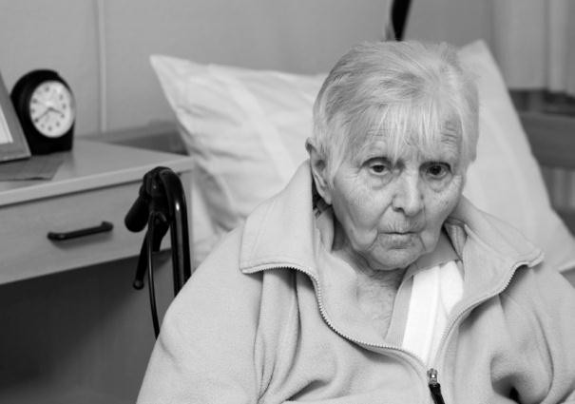
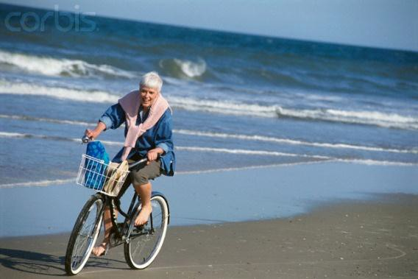
Make Situational Decisions
Do physical outcomes outweigh psychological outcomes?
Who gets to make the choice?
Can a situation be too safe?

Slide 18
The discussion should start with…
“What risks are you willing to take to optimize the quality of your life?”
“Who do you talk with about decisions you make?”
“How would you know if you started to need help?”

Slide 19
Changing Perceptions of Older Adults
Mood and Cognitive Issues are NOT an expected outcome of aging
Collaborative approach by including the older adult
Self Awareness as the Health Care Professional of bias, feeling overwhelmed and hopeless interpretations of issues

Slide 20
“Yes I’m 100 years old but don’t tell anybody because as soon as you do they won’t think I know what I am talking about.”
www.nln.org/ACES

