Slide 1
Mental Health Issues and Older Adults
Mini Case Studies

Slide 2
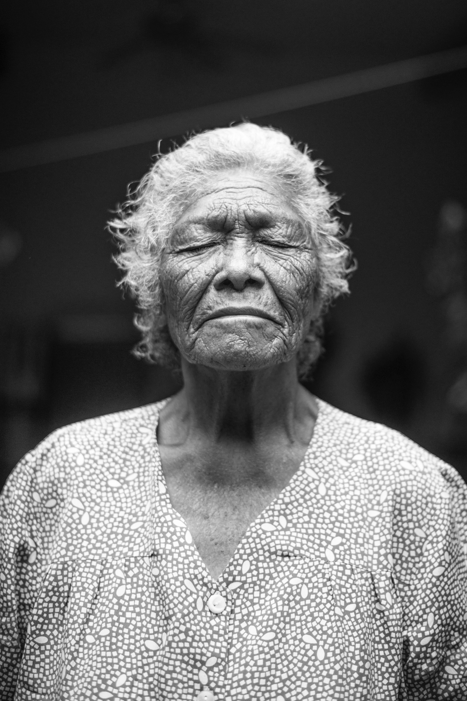
Sylvia, age 94 years
“I don’t know what happened. I always like to knit for charity and meeting my grandchildren for lunch and now everything gets on my nerves…yesterday I screamed at a lady at my dinner table…that is not me…I can’t seem to stay sill yet I also get nothing done…maybe I would be better off dead…”

Slide 3
Sylvia
What tools would be useful in assessing Sylvia?
What other questions would the nurse ask Sylvia?
What otter factors might be contributory in this case?

Slide 4
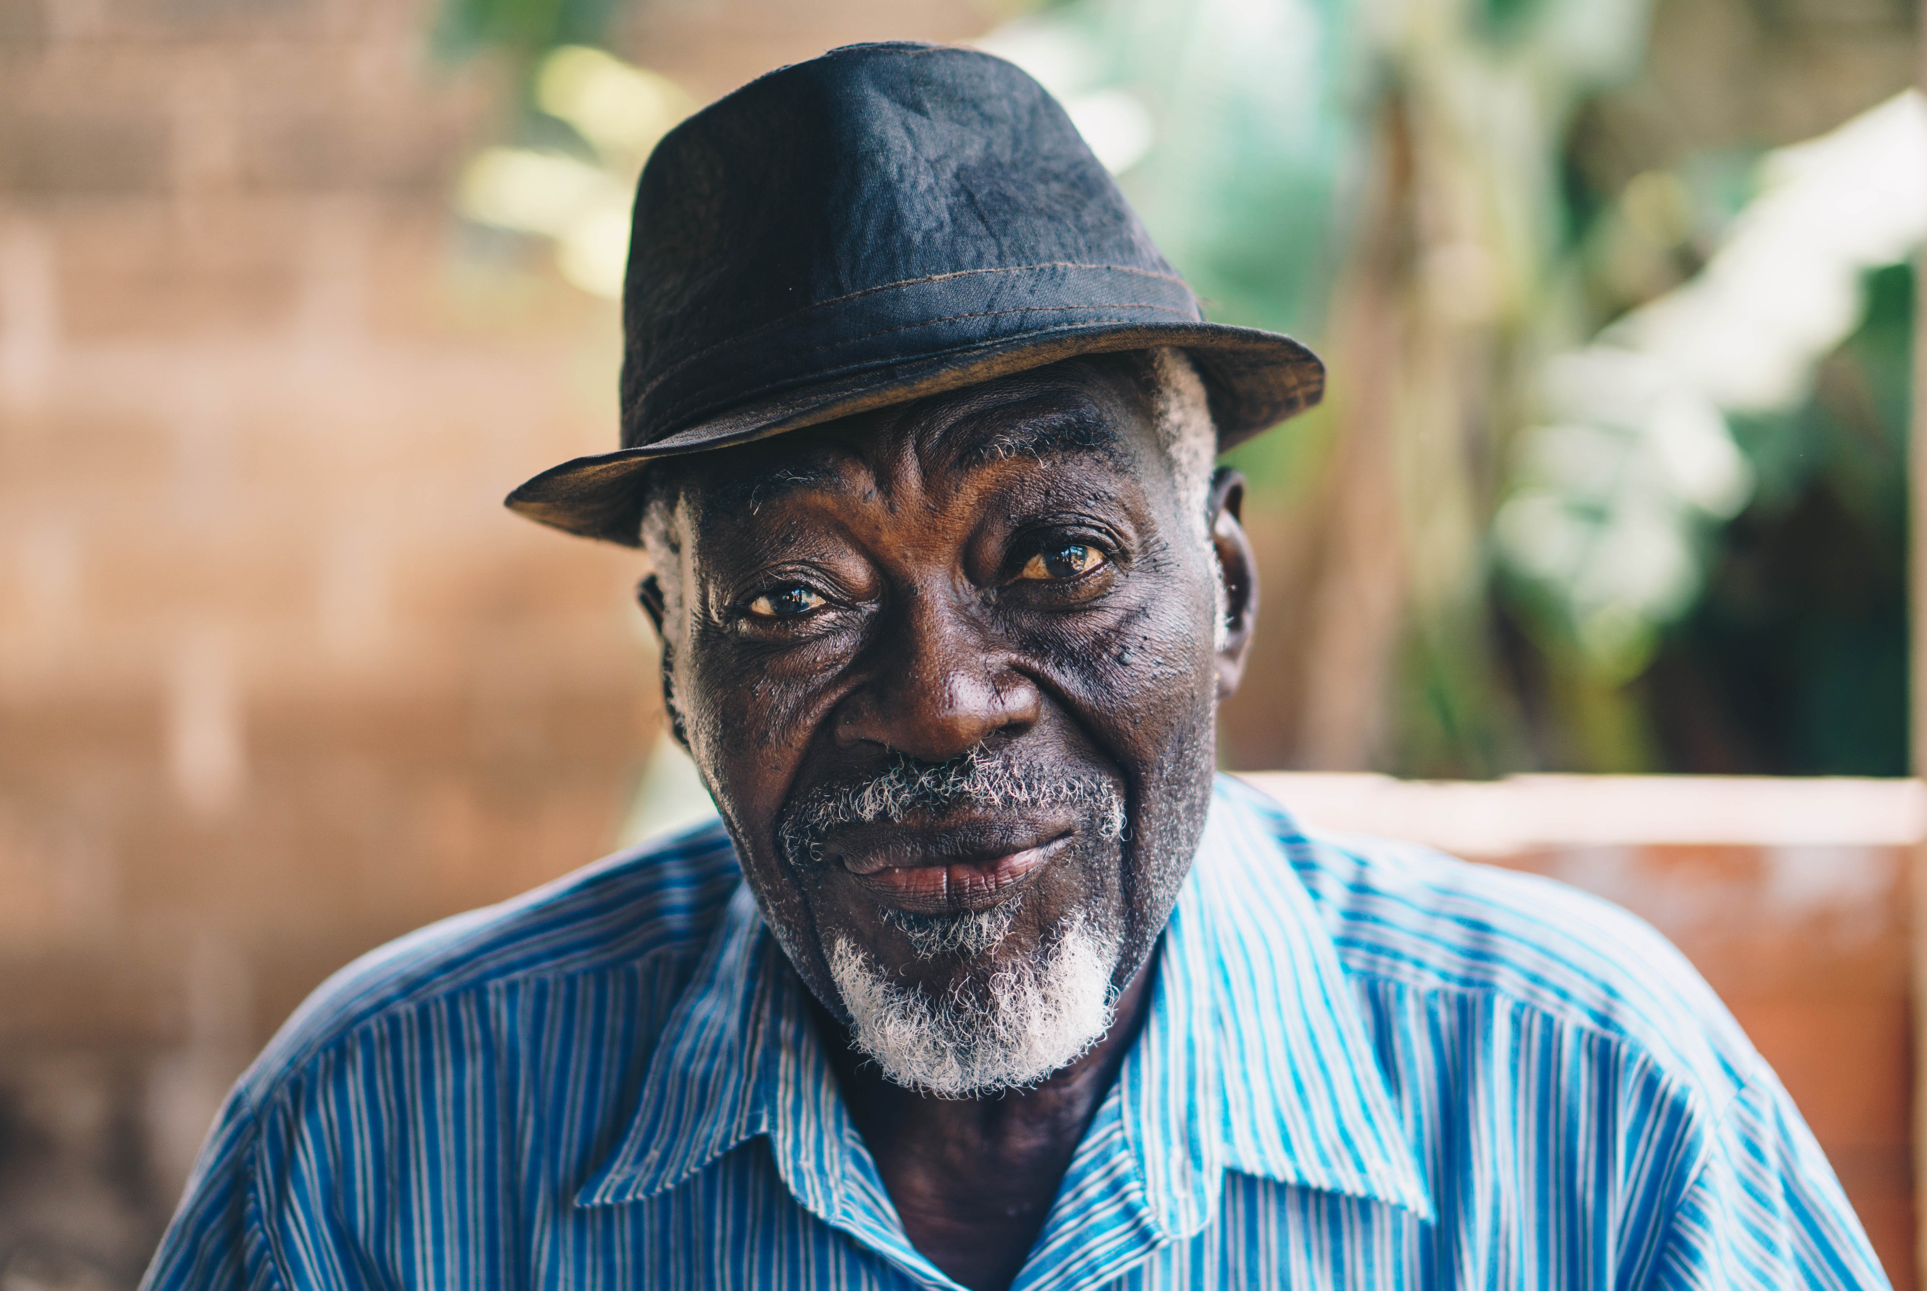
Sam, age 86 years
“I am doing fine but I wish I could convince my kids of that…so I didn’t balance my checkbook just so last month…I forgot to pay the gas bill…big deal. I know plenty of people who do that. I got a bit lost coming home from the store the other night–it could happen to anybody…I think I do okay so I got lost coming home from the store…”

Slide 5
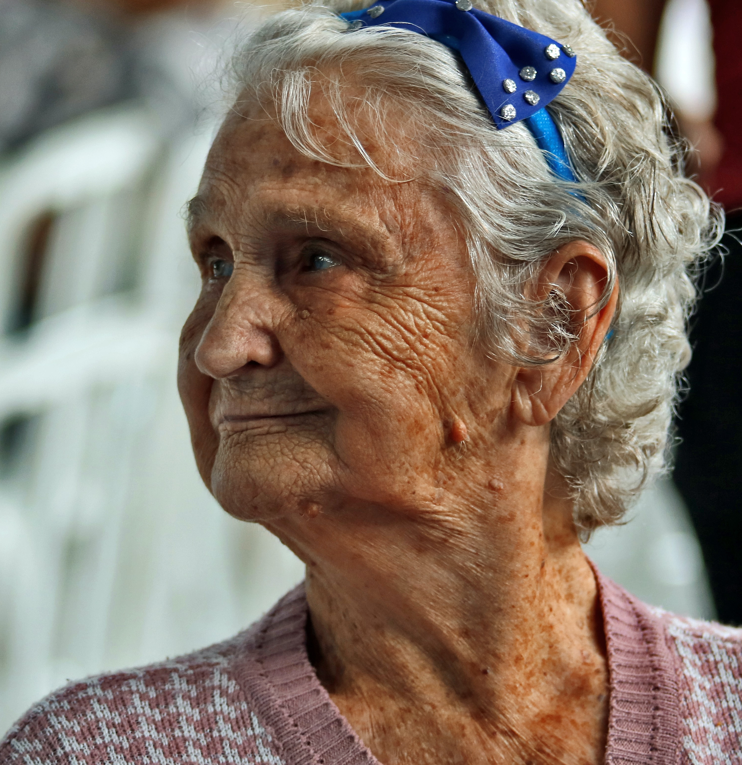
Dee, age 77 years
“It was so strange that they allow dogs and cats in the hospital now…I saw them under the bed at the hospital…the nurses didn’t seem to mind…so I guess they don’t mind here either…do you see the nice kitty over there…?”

Slide 6
Harold, age 89 years
“I knew that the stroke was going to slow me down a bit, but I didn’t know how much. My kids decided that I could no longer live on my own…Physically and mentally I was failing they said…They found a nice retirement community close to where they lived…I would live in what is called assisted living…have my own apartment, come and go as I pleased…They packed up my home in no time flat and boom – I was moved…But I was still working…not much, but I had a few cases I was working on…this didn’t seem to matter…”

Slide 7
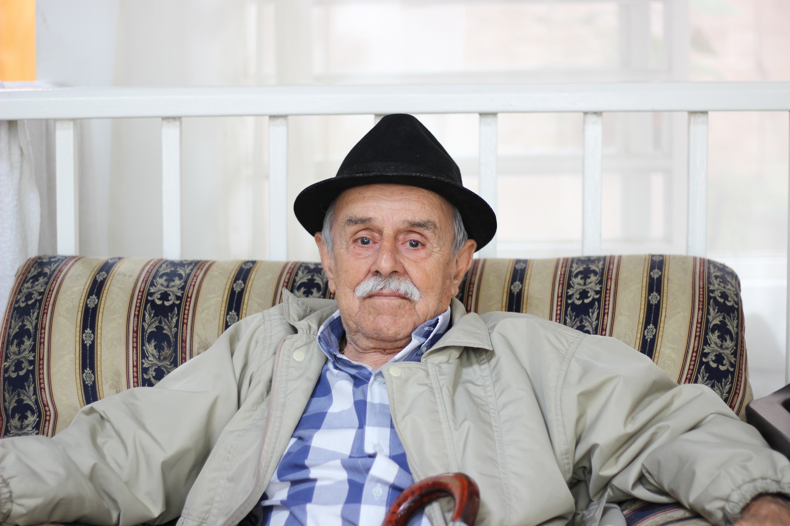
Harold
Physical and psychiatric assessment
Outcome predictors from physical and psychiatric
Past history
Harold’s expectations versus family expectations
Individual aging patterns

Slide 8
“Why does everybody always look at my daughter for the answer when they ask me the questions…I know I was depressed and sick for a period of time but hey…here I am now”

