Slide 1
WHAT DO YOU
REMEMBER ABOUT
ALZHEIMER’S DEMENTIA?
Notes:
Created by Educational Technology Network. www.edtechnetwork.com 2009

Slide 2
 | 2 | Topic 3 | Topic 4 | Topic 5
10 | 10 | 10 | 10 | 10
20 | 20 | 20 | 20 | 20
30 | 30 | 30 | 30 | 30
40 | 40 | 40 | 40 | 40
50 | 50 | 50 | 50 | 50
WHAT’S IT ALL ABOUT
MORE
PATHS TO
PHYSIOLOGY
WHY DOES
IT ALL
HAPPEN
PATHO MY
PHYSIOLOGY
HELP ME
REMEMBER
Notes:
Click onto the number to reveal the question and advance to the next slide for the answer.
Remember to click onto the house in the bottom right side of the answer slide to return to this slide for the next participant to choose a topic

Slide 3
Question 1 - 10
What is the biggest risk factor for getting Alzheimer’s Dementia?

Slide 4
Answer 1 – 10
AGE
Notes:
Approximately 4% of people diagnosed with Alzheimer’s dementia are under age 65, 6% are 65–74, 45% are 75–84, and 50% are 85 or older.
As we know the population of the Unitized States is aging and living longer thereby increasing the numbers of at risk people. As the population lives longer so will the number of people diagnosed with Alzheimer’s dementia. By 2030 it is estimated that more than 7.7 million people will be diagnosed with Alzheimer’s dementia which is about a 50% increase over the current numbers (Alzheimer's Association, 2012).
The risk of age as an influence in getting Alzheimer's dementia is consistent with other diseases such as heart disease.

Slide 5
Question 1 - 20
What racial and ethnic group is more likely to be diagnosed with Alzheimer’s dementia?

Slide 6
Answer 1 – 20
Non Hispanic whites
Notes:
The majority people in the United State with Alzheimer’s dementia are non-Hispanic whites. However when taking into account the numbers of African Americans and Hispanics they are more proportionately likely than older whites to have Alzheimer’s dementia. In persons ages 65 or older, 7.8% of whites, 18.8% of African-Americans, and 20.8% of Hispanics have AD or other dementias. Health conditions such as high blood pressure and diabetes and other differences in socioeconomic characteristics that are risk factors for AD and vascular dementia (Alzheimer's Association, 2012).
Here is a link to a fact sheet on race and ethnicity pertaining to Alzheimer's dementia :
https://aaic.alz.org/downloads2020/2020_Race_and_Ethnicity_Fact_Sheet.pdf

Slide 7
Question 1 - 30
Are males or females more likely to be diagnosed with Alzheimer’s Dementia and why?

Slide 8
Answer 1 – 30
Females because women live longer
Notes:
Approximately 66% of Americans with AD are women. It is estimated that of the 5.2 million people over the age of 65 with AD in the United States, 3.4 million are women and 1.8 million are men. This is explained by the fact that women live longer on average than men and not that women are more likely than men to develop dementia (Alzheimer’s Association, 2012).

Slide 9
Question 1 - 40
What is the relationship between education and likelihood of being diagnosed with Alzheimer’s Dementia?

Slide 10
Answer 1 – 40
People with less education are more likely to be diagnosed with Alzheimer’s Dementia
Notes:
The risk associated with a diagnosis of Alzheimer’s Dementia and less education is linked to the cognitive reserve those with more education may have. The cognitive reserve allows them to better compensate for the changes in the brain, and the symptoms may not be as readily evident. While more education can be somewhat protective, and an individual may not show the signs of the disease as quickly once the disease is diagnosed this factor does not seem to protect against the progression of the disease.

Slide 11
Question 1 - 50
What is the annual cost of Americans diagnosed with Alzheimer’s Dementia?
100 Million Dollars
200 Million Dollars
200 Billion Dollars
One Trillion Dollars

Slide 12
Answer 1 – 50
$200 BILLION
Notes:
Alzheimer’s disease (AD) inflicts a heavy economic burden on families and on society as a whole. According to the Alzheimer’s Association, the cost of caring for individuals with AD is estimated in 2012 to be $200 billion annually and is projected to increase to $1.1 trillion in 2050. Medicare and Medicaid currently cover about 70% of the costs of care for patients with AD. It does not cover private help unless the individual qualifies under state funded Medicaid programs and is accessed by local agencies. It is very rare that a person would quality for 24 hour help in their home. Clients who have long-term care insurance, may receive coverage for home healthcare, but many families must pay all or most of the cost themselves.
Although the number of persons diagnosed with AD is increasing, the mortality rate of these individuals is decreasing. Patients with AD have significantly more co-morbid medical conditions and higher healthcare costs and utilization than demographically matched Medicare beneficiaries. Medicaid is the only major source of financial assistance for long-term care for people with Alzheimer’s disease.
The staggering costs of AD for families—home healthcare, adult daycare, caregiver respite, and long-term care—are seldom covered by medical insurance or Medicare, which is intended to cover the acute healthcare needs of people over 65 and disabled people under 65. Currently there are 14.9 million unpaid caregivers, and 80% of care for dementia patients is provided at home by family caregivers. Fewer than 10% of dementia patients receive all their care from paid workers. The unpaid caregivers are primarily immediate family members but also include other relatives and friends. In 2011 they provided $17.4 billion of unpaid care valued at over $210 billion (Alzheimer’s Association, 2012).

Slide 13
Question 2 - 10
Alzheimer’s Dementia is:
A brain disease with an uncertain etiology
B. An expectation of aging worsened by stress
A genetic disease with early treatment cure options

Slide 14
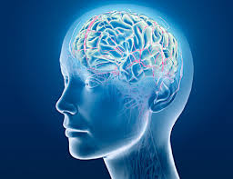
Answer 2 – 10
A brain disease with an uncertain etiology
Notes:
Alzheimer's Dementia is a progressive brain disease with clear changes in the brain’s chemistry and function. While there are clear trends that are noted in the brains of people with Alzheimer’s dementia there is not a clear cause and effect pattern. Researches continue to make progress in better understanding these trends but have thus far been unable to reserve the symptoms of the disease nor offer a way to fully prevent the disease. There is research that looks at certain modifiable risks that can be addressed to retain cognitive function such as diet and exercise however there are not fully protective. Age is a risk factor but Alzheimer’s dementia is not an expectation of aging, and while stress can be a contributing factor it is not the only factor that contributes. There are genetic relationships especially with early onset dementia but treatment options do not cure the disease. This type of dementia (early onset ) is generally more aggressive than the late onset dementia.
The bottom line is scientists suggest that Alzheimer’s Dementia disease related to the interaction of genetic, environmental, and lifestyle factors over many years, which lead to changes in brain structure and function. Again this is not different than many of the physiological diseases studied such as cardiovascular disease, diabetes and arthritis.

Slide 15
Question 2 - 20
The hallmark of Alzheimer’s Dementia is:
A. Increase in the size of the brain
B. Large numbers of neurofibrillary tangles and plaques in the brain
C. Over functioning of the Limbic System

Slide 16
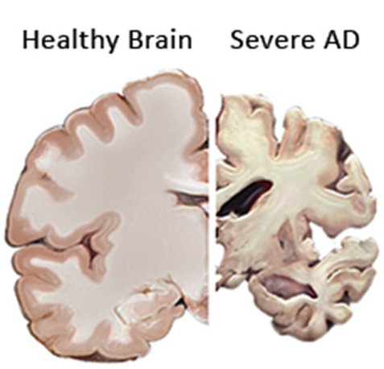
Answer 2 – 20
Large numbers of neurofibrillary tangles and plaques in the brain
Notes:
Alzheimer's tissue has many fewer nerve cells and synapses than a healthy brain.
Plaques, abnormal clusters of protein fragments, build up between nerve cells.
Dead and dying nerve cells contain tangles, which are made up of twisted strands of another protein.
While Scientists are not absolutely sure what causes cell death and tissue loss in the Alzheimer's brain; plaques and tangles are strongly suspected

Slide 17
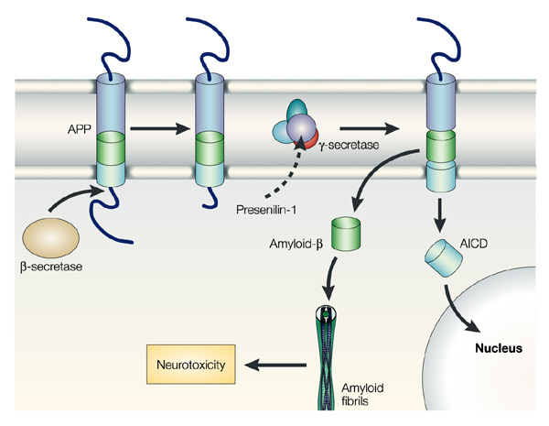
Question 2 - 30
What are the two enzymes that break up the Amyloid precursor protein (APP)?

Slide 18
Answer 2 – 30
Beta and gamma secretase
Notes:
APP is produced by health neurons in the brain. The disease process which occurs in Alzheimer’s dementia and causes brain dysfunction is secondary to beta and gamma secretase enzymes breaking down the APP . Disease progression occurs with increased enzyme activity which further interrupts brain function

Slide 19
Question 2 - 40
Beta-amyloid plaques are:
Sticky proteins that fold into clumps called fibrils
Fluid proteins that dissolve around the fluid surrounding neurons
Enzymes that preserve brain function

Slide 20
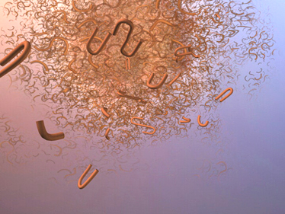
Answer 2 – 40
A sticky protein that fold into clumps called fibrils
Notes:
A short, sticky protein; beta-amyloid. Instead of dissolving in the fluid that surrounds the neurons, beta-amyloid protein folds into insoluble clumps called fibrils. The fibrils stick together, resulting in plaques on the surface of the neuron. Beta-amyloid plaques are one of two characteristic lesions of AD. Plaques initially develop in the part of the brain which houses memory and cognitive functions such as reasoning and judgment. The research is still unclear as to whether the plaques cause Alzheimer’s dementia or are a byproduct .

Slide 21
Question 2 -50
Beta-Amyloid plaques are one of the distinctive lesions seen in Alzheimer’s Dementia…
What are the other lesions that is characteristic of this disease?

Slide 22
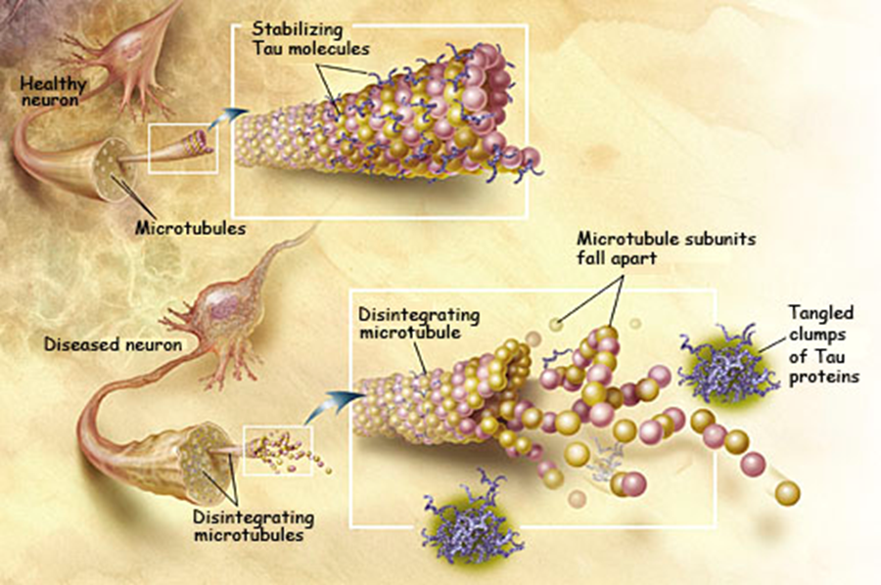
Answer 2 – 50
Neurofibrillary Tangles
Notes:
The other lesion that characterizes AD is called a neurofibrillary tangle that forms inside the neuron itself. Normally, healthy neurons connect with each other through slender appendages or branches called neurites. The neurites contain microtubules that maintain the shape of the cell and serve as its life support system, carrying nutrients and neurotransmitters.
Remember your pathophysiology of the neuron. The walls of the microtubules are reinforced by tau proteins, which act like the rungs on a ladder or rails on a track. Tau holds these rungs or rails together. In AD, the tau proteins loosen and form neurofibrillary tangles. Without the normal reinforcing effect of the tau proteins, microtubules with loose tau proteins disintegrate, cutting off life support to the neuron, which then shrivels and dies.

Slide 23
Question 3 - 10
Notes:
WHAT IS THE DIFFERENCE
BETWEEN ALZHEIMER’S
DEMENTIA AND DEMENTIA?

Slide 24
Answer 3 – 10
Notes:
The other types of dementia include vascular dementia, frontotemporal dementia, Parkinson’s dementia, HIV dementia…these are asked in a question in the I Can’t Remember section of the game.
The name Alzheimer’s dementia has a negative stigma attached to it, generally because of the lack of understanding of the illness. Many family members would prefer another diagnosis such as vascular dementia because of this stigma and likely because of the negative connotations associated with the disease.
ALZHEIMER’S DISEASE
IS SIMPLE ONE TYPE OF DEMENTIA
IT HAPPENS TO BE THE
MOST PREVALANET TYPE
OF DEMENTIA

Slide 25
Question 3 - 20
Neurotransmitters in the brain act as transmitters of nerve impulses, or chemical messengers.
Individuals with Alzheimer’s Dementia have a decreased amount of neurotransmitters .
Name two of the neurotransmitters that are reduced in the brains of individuals diagnosed with Alzheimer’s Dementia.

Slide 26
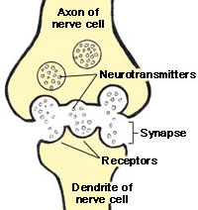
Answer 3 – 20
Acetylcholine
Serotonin
Norepinephrine
Somatostatin
Notes:
Reduction of achetylchomine is initially seen in the areas around the hippocampus which of course is responsible for memory synthesis – short term to long term.

Slide 27
Question 3 - 30
How do the plaques and tangles associated with Alzheimer’s Dementia contribute to the later symptoms of the disease?

Slide 28
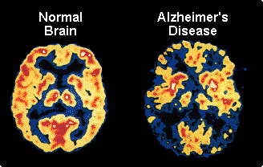
Answer 3 – 30
Simple they expand in the brain to affect the parts of the brain that control speaking and understanding language thus further contributing to the individual’s ability to function.
Notes:
As the disease progresses the plaques and tangles attack the areas of the brain responsible for swallowing, coordination, mobility, and the most basic life functions.
It may be helpful to show students the Global Deterioration Scale developed by Barry Reisingberg, MD.; the classic scale that looks at the decompensation of functioning:
https://www.mirecc.va.gov/visn21/pdf/gds_basic_package.pdf
The scale can be compared to the reverse developmental progression of infants. The last stage is consistent with the needs and functioning of an infant. The purpose in this comparison is not to compare adults with Alzheimer’s Dementia with children (as it should be stressed that approaches to managing issues with children is very different than with adults with Alzheimer’s Dementia) but to see how the disease process systematically progresses to take away function.

Slide 29
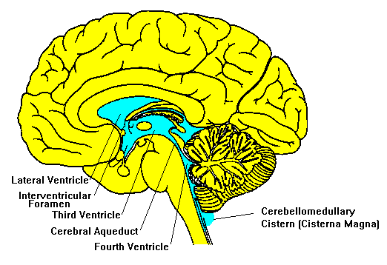
Question 3 - 40
What are the changes that are evident in the ventricles of the brain of people with Alzheimer’s Dementia?

Slide 30
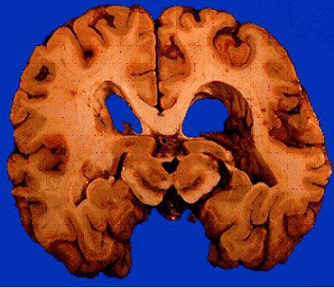
Answer 3 – 40
Enlarged ventricles
Notes:
The ventricles or chambers that contain cerebrospinal fluid in the Alzheimer's diseased brain are noticeable enlarged. Of course there is also an overall shrinkage of the brain and the sulci are widened. In addition the folds of the brain’s outer layer; the gyri are smaller. While this is not necessarily diagnostic of Alzheimer’s Dementia it is another piece of the puzzle for the practitioner who is making the diagnosis

Slide 31
Question 3 - 50
What part of the brain is responsible for the transfer of short term memory to long term memory as well as for spatial memory?

Slide 32
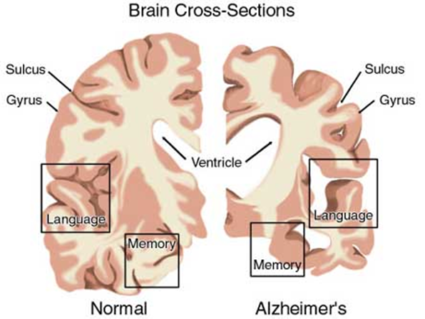
Answer 3 – 50
Hippocampus
Notes:
In Alzheimer’s dementia the hippocampus is the first region which shows deterioration thus accounting for the short term memory symptoms and the inability to synthesize new information which is often the first signs evident in an individual with Alzheimer’s dementia.
The hypothalamus is also in the limbic system like the hippocampus but it functions to control thirst, hunger and circadian rhythm
The brain stem which consists of the midbrain, pons and medulla is responsible for basic life function such as breathing, heartbeat and blood pressure

Slide 33
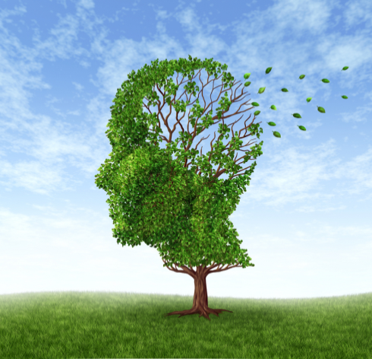
Question 4 - 10
Is there a more significant genetic risk factor in the development of early- onset Alzheimer’s dementia v. late-onset dementia

Slide 34
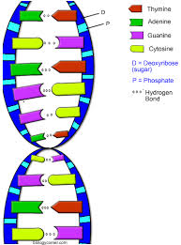
Answer 4 – 10
There is a much more significant genetic risk of developing early-onset Alzheimer's Dementia
Notes:
Early onset Alzheimer’s disease occurs in people under the age of 65 and is rare (Occurs in less than 5% of diagnosed cases). Late-onset Alzheimer’s dementia is the most common form of the disease and occurs after the age of 65 with a higher risk of being diagnosed with advancement in age. There is a much more impressive genetic link with early-onset.

Slide 35
Question 4 - 20
What is the gene most associated with influencing a risk of Alzheimer’s Dementia and is testing for this gene used part of a diagnostic workup?

Slide 36
Answer 4 – 20
APOE-e4 - no testing for this gene is not part of a normal workup for cognitive loss
Since APOE-e4 is considered a risk gene (one that is likely to cause the disease but not with a 100% correlation) there are many ethical, financial, and psychosocial complications that could impact an individual who tests positive for the gene possible decades before becoming symptomatic.
Notes:
APOE-e4 is found in excess amounts in people with Alzheimer’s dementia and Down Syndrome (individuals with Down syndrome have a significantly increased rate of Alzheimer’s dementia) Alz.org research center: This site has two videos which are part of the NIH Alzheimer’s Project. These videos (see links below) demonstrate the role of the APOE-e4 in Alzheimer’s Dementia as well as the role of genes in the ongoing Alzheimer’s research. https://www.alz.org/research/science/alzheimers_disease_causes.asp There are two categories of genes that influence whether a person develops a disease: (1) risk genes and (2) deterministic genes. Researchers have identified Alzheimer’s genes in both categories.
Genetics in Alzheimer’s video (1:41)
https://youtu.be/vYZ1RppCysQ?si=S6aP8nHdYdOqWXIY
Risk genes increase the likelihood of developing a disease, but do not guarantee it will happen. Researchers have found several genes that increase the risk of Alzheimer’s. APOE-e4 is the first risk gene identified and remains the gene with strongest impact on risk. APOE-e4 is one of three common forms of the APOE gene; the others are APOE-e2 and APOE-e3. Everyone inherits a copy of some form of APOE from each parent. Those who inherit one copy of APOE-e4 have an increased risk of developing Alzheimer's. Those who inherit two copies have an even higher risk, but not a certainty. In addition to raising risk, APOE-e4 may tend to make symptoms appear at a younger age than usual. Scientists estimate that APOE-e4 is implicated in about 20 percent to 25 percent of Alzheimer's cases.
Late-Onset Genes for Alzheimer's Disease (1:27)
https://youtu.be/5z9d-UG8J3I?si=8Gq6CVtYEZJgDyWT
Earlier Diagnosis
https://www.alz.org/alzheimers-dementia/research_progress/earlier-diagnosis

Slide 37
Question 4 - 30
What is the difference in genetic markers in early onset Alzheimer’s Dementia (AD) and late onset AD?

Slide 38
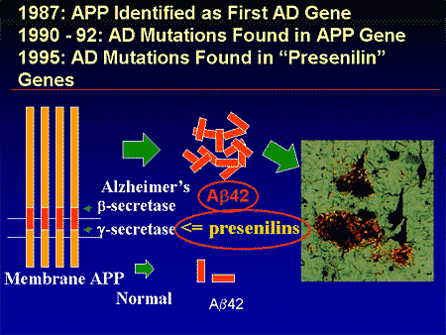
Answer 4 – 30
Mutations of three different genes on three different chromosomes
Notes:
Mutations in the APP gene on chromosome 21
Mutations in the presenilin 1 gene on chromosome 14
Mutations in the presenilin 2 gene on chromosome 1
These mutations cause the abnormal formation of proteins and the breakdown of APP (amyloid precursor protein) which is known to generate the destruction forms of the amyloid plaques.
While there is no specific gene that is linked to the late onset variation of the disease the APOE-e4 gene found on chromosome 19 is evident and plays a role in the development of the disease. The exact mechanism is still not entirely understood.

Slide 39
Question 4 - 40
We know that advancing age and family history can be contributing factors to the development of Alzheimer’s Dementia.
What are other possible contributing factors?

Slide 40
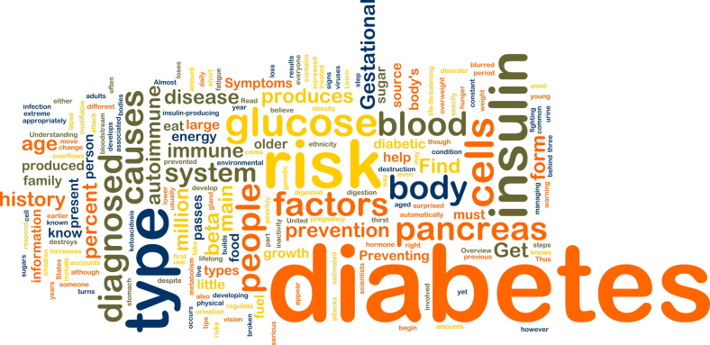
Answer 4 – 40
Diabetes
Depression
Smoking
Notes:
Major depression in late life may directly damage part of the brain involved in learning and memory by inflammation or the release of stress hormones which in turn releases cortisol. The Framingham Heart Study started in 1948 to identify risk factors associated with heart disease, found that depression was a significant risk factor in heart disease. It is felt that a decline in mood may act with other biological factors that have been liked to dementia. These same biological factors leading to late life depression also lead to dementia. It is unclear as to whether the connection is between depression and dementia or if the vulnerability to depression leads to a vulnerability to Alzheimer’s dementia. (Spalletta et al., 2012).
http://www.framinghamheartstudy.org/
Diabetes has been linked to Alzheimer’s Dementia in terms of the harmful effects of high blood sugar on the brain. The exact mechanism is not known. Diabetes raises the risk of cardiovascular disease; too much insulin affects the chemical makeup of the brain and high blood sugar causes inflammation.
Smoking is linked to the development of Alzheimer’s dementia. Specifically heavy smoking which is defined as smoking more than two packs of cigarettes a day. Heavy smoking is associated with a 157% chance of being diagnosed with Alzheimer’s dementia and 172% risk of developing vascular dementia (Rusanen et al., 2011). The effect of smoking on the vascular system is a clear risk to the development of vascular dementia . Of course the toxic chemicals and metals in cigarettes are also contributory.
There have been studies trying to link environmental factors such as metals and lead with Alzheimer’s dementia, however there is no conclusive evidence to support these finding.

Slide 41
Question 4 - 50
Chronic stress is a risk factor for AD because it:
Raises the risk of heart disease.
Causes inflammation.
Triggers excessive cortisol production.
Affects chemicals on which the brain depends.

Slide 42
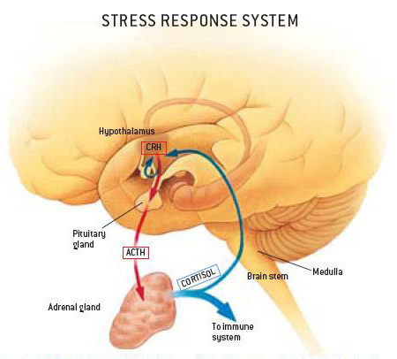
Answer 4 – 50
Triggers Excessive cortisol production
Notes:
Chronic stress may be implicated in AD because of consistently high cortisol levels that can cause brain cell dysfunction, kill brain cells, and lead to brain atrophy. Several studies have shown that this increases the risk for Alzheimer’s disease (Fillit, 2010).

Slide 43
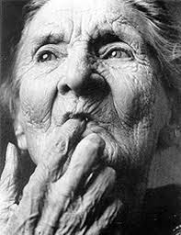
Question 5 - 10
How is a diagnosis of Alzheimer’s Dementia made?

Slide 44
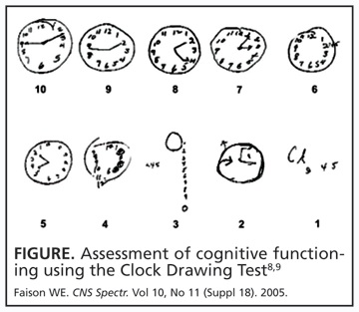
Answer 5 – 10
Any other causes of cognitive decline are ruled out
Cognitive Examination
History
Notes:
Alzheimer’s Dementia is a diagnosis of exclusion initially ruling out other medical conditions that could be presenting with similar symptoms. These include hypothyroidism, stroke, nutritional deficiencies, Brain tumor, delirium, hydrocephalus and chronic alcohol use. Initial laboratory testing usually includes (B-12, Folate, TSH, CBC, LFT, Sedimentation Rate, RPR). In addition brain imaging is done; wither an MRI or a PET scan. A definitive diagnosis is still only made by autopsy.
The cognitive exam includes one of the following assessments:
MMSE (Mini Mental Status Exam) - https://cgatoolkit.ca/Uploads/ContentDocuments/MMSE.pdf
Montreal Cognitive Assessment MoCA - https://mocacognition.com/
Finally, the history from the family and client related to deficient and the time frame of these deficits. Remember treatment is sought out for different reasons and the symptoms may be prevalent for many years until a crisis brings the family to treatment or they may enter treatment at the first signs of cognitive decline. The practitioner making the diagnosis looks at a change in functioning. For example, a person who always paid their bills and now is making frequent mistakes indicates a change in executive functioning, however if an individual never paid bills this is not an appropriate area to access.
A definitive diagnosis of AD is still only possible at autopsy.
It is important to note that Medicare’s new Annual Wellness Visit
Includes an assessment of cognition. Hopefully, earlier assessment will yield earlier diagnosis and earlier treatment. Having a baseline cognitive exam on file also helps with future comparisons of functioning.

Slide 45
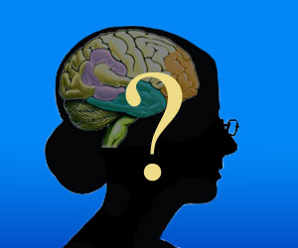
Question 5 - 20
Name two other types of Dementia other than Alzheimer’s Dementia

Slide 46
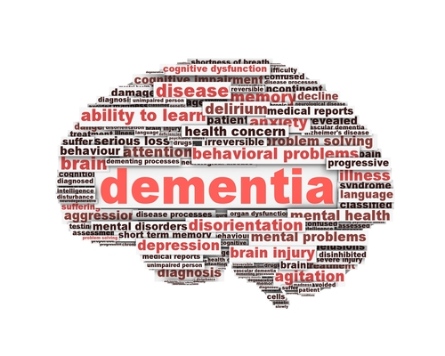
Answer 5 – 20
Vascular Dementia
Dementia with Lewy bodies (DLB)
Parkinson’s Dementia
Frontal Lobe Dementia
Notes:
https://www.alz.org/alzheimers-dementia/what-is-dementia/types-of-dementia
Vascular Dementia: This is the second most common cause of dementia after Alzheimer’s Disease. The old term was multi-infarct dementia. It is marked my an initial symptom of impaired judgment as opposed to the memory issues of Alzheimer’s dementia. Changes in the vascular structure of the brain; microscopic bleeding and blood vessel blockage such as strokes, sustained hypertension, transient ischemic attacks are contributory. Previously vascular risks and evidence of this on brain imaging strongly suggested vascular dementia however more recent studies indicate that there is likelihood of a mixed Alzheimer and vascular etiology. Treatment is the same for both.
Dementia with Lewy bodies (DLB): This is often marked by significant visual hallucinations as the predominate symptoms with memory loss. They also have more sleep disturbances than Alzheimer’s dementia. Abnormal aggregations or Lewy bodies of protein that when developed in the cortex can produce DLB.
Parkinson’s Dementia: The progression of Parkinson’s disease can result in a progressive dementia, however not every person diagnosed with Parkinson’s disease will have a cognitive loss. In addition to memory and cognitive functioning issues hallucinations can be present but the etiology needs to be clear as the pharmacological treatments for Parkinson’s disease often produce hallucinations as a side effect.
Frontotemporal Dementia(FTD): Changes in personality and behavior, specifically disinhibition are often the hallmark of FTD.
The frontal area of the brain is most affected. Generally symptoms are developed at a younger age than other dementias.
Creutzfeldt-Jakob disease is a dementia that is rapidly fatal and disorder that also can affect cattle hence the name mad cow disease. The brain changes result from misfolded prion proteins causing the death of brain cells. Infectious CJD accounts for only 1% of those cases diagnosed with the disease and is the result of an infectious process.
Normal pressure hydrocephalus(NPH): Symptoms of include the triad of memory loss, incontinence and unsteady gait. The brain changes are the result of an accumulation of fluid in the brain. It can often be corrected by the surgical installation of a shunt in the brain to drain the excess fluid.
Wenicke-Korsakoff Syndrome: The cognitive loss of this disease is caused by the brain’s deficiency of thiamine(B-1). Thiamine helps in the conversion of sugar to energy however when a thiamine level is low this conversion cannot be properly generated.

Slide 47
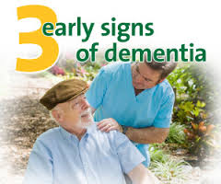
Question 5 - 30
What are the hallmarks of the initial stages of dementia?

Slide 48
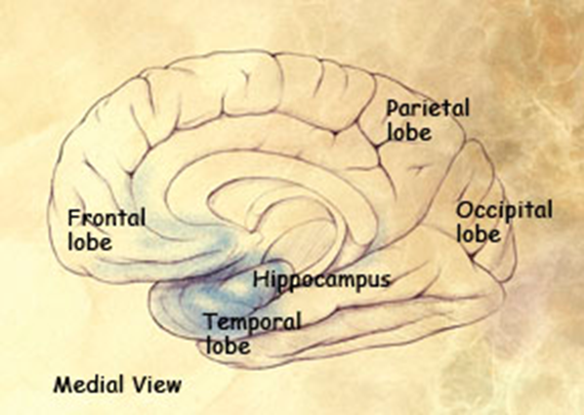
Answer 5 – 30
Short term memory impairment
Executive Functioning deficits
Inability to learn new information
Notes:
Photo shows early damage to the hippocampus
Executive functioning deficits: paying bills, handling money
Memory loss: poor recent memory
Making bad decisions that are uncharacteristic (investments, putting self in dangerous positions)
Mild anomia (impairment in naming persons or objects)
Getting lost in familiar places (ie: going to the grocery story)
Taking longer to accomplish normal daily tasks
loss of spontaneity and sense of initiative (depression needs to be ruled out v. the apathy associated with dementia)
Mood and personality changes, increased anxiety( generally there is some awareness that something is not quite right which may intensify the anxiety)
It is important to remember that no two people are the same and different presentations of the disease are common

Slide 49
Question 5 - 40
What are symptoms seen in the middle stages of Alzheimer’s dementia?

Slide 50
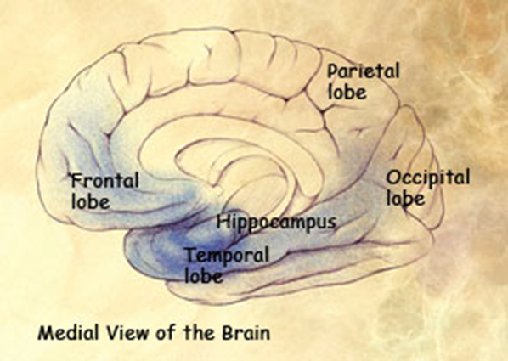
Answer 5 – 40
Behavioral Problems
Extension of Memory Issues
More pronounced language struggles
Notes:
Picture shows more expansive deterioration of the brain into the frontal and temporal lobe
An increase in behavioral problems is evident which subsequently require increased supervision. In addition those afflicted with Alzheimer’s dementia don’t know that they don’t know. There is an expansion in brain deterioration in the areas of the brain that control language, sensory processing and reasoning. The result is more prevalent symptoms including:
Increasing memory loss, both remote and recent
Shortened attention span
Problems recognizing friends and family members
Difficulty with language; problems with reading, writing, numbers
Difficulty organizing thoughts and thinking logically
Inability to learn new things or to cope with new or unexpected situations
Restlessness, agitation, anxiety, tearfulness, and wandering, especially in the late afternoon or at night
Loss of ability to tell time; late-day time disorientation and confusion, called “sundowning”
Repetitive statements or movement, occasional muscle twitches
Hallucinations, delusions, suspiciousness or paranoia, irritability
Loss of impulse control and social skills (sloppy table manners, undressing at inappropriate times or places, vulgar language)
Perceptual-motor problems (trouble getting out of a chair or with fine motor movements)

Slide 51
Question 5 - 50
What are the symptoms seen in the later stages of Alzheimer’s Dementia?

Slide 52
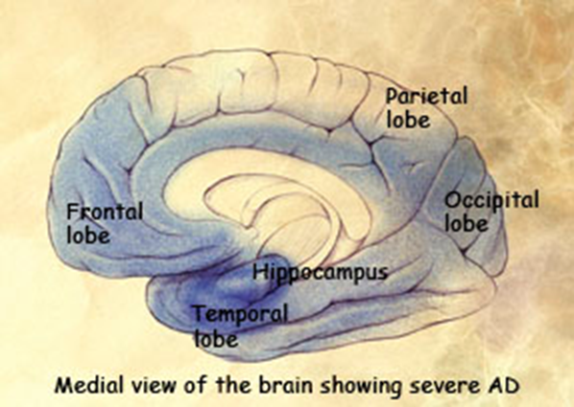
Answer 5 – 50
Extension of memory loss; long and short term loss
Physical impairment resulting in unsteady gait, falls and reduced mobility
Total care with all activities of daily living
Difficulty Swallowing
Notes:
Picture shows continued and expansive brain deterioration extending to cause increased damage of the hippocampus and the spread of disease throughout the frontal, temporal, occipital and parietal lobes.
Increased disease translates to increased symptoms and decreased functioning.
Impaired swallowing, which can lead to aspiration pneumonia (the most common cause of death in AD patients)
Since memory is so impaired and the ability to learn new information virtually impossible, client’s who fall and require rehabilitation have very poor outcomes as they have difficulty cooperating in physical therapy.

